Slide 1
ESE 562 Project 3
Po Hsu Chen, 448031
Dec 7, 2017

Slide 2
System level architecture with component values (C, Io, CLK, VREF, VCMP)

Slide 3
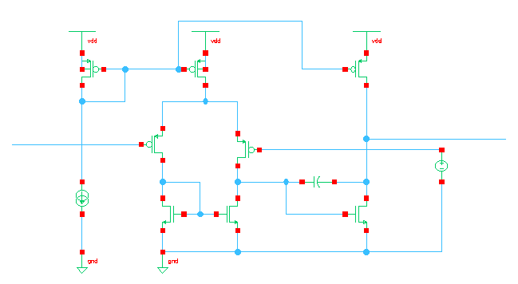
Amplifier Implementation

Slide 4
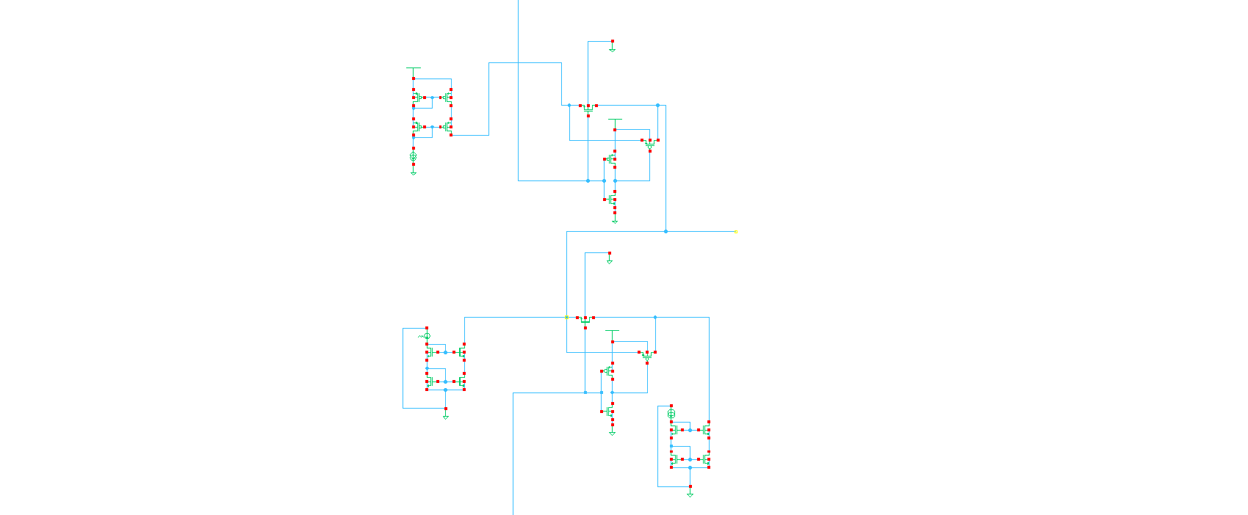
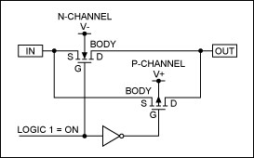

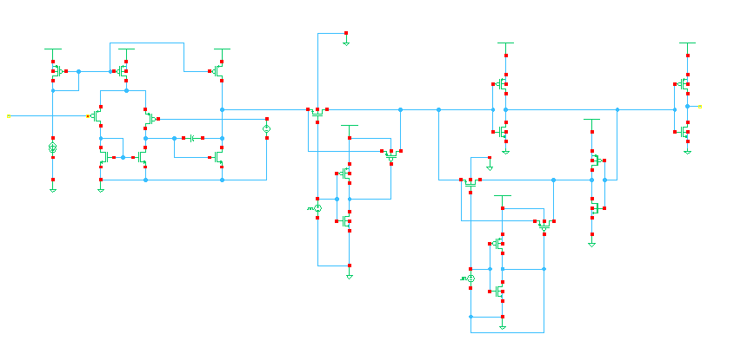
Implementation
Current Source and Sink
CMOS Switch
Latched Comparator

Slide 5
Using transient analysis ramp the input current from 0 to 100nA. Plot the output of the modulator using a moving window. Also plot the voltage Vx

